Slide 1
Unit-III
Exception Handling

Slide 2
Types of errors
Errors broadly classified into two categories.
  Compile-time errors
  Run-time errors.

Slide 3
Compile-Time Errors
Missing semicolons.
Missing brackets in classes and methods.
Misspelling of identifiers and keywords.
Missing double quotes in strings.
Use of undeclared variables.
And so on.

Slide 4
Run-Time Errors
Dividing an integer by zero.
Accessing an element that is out of the bounds of an array.
Attempting use a negative size of an array.
Converting invalid string to a number.
Accessing a character that is out of bounds of a string.
Using a null reference to access a method or a variable.
Missing input file.
And so on.

Slide 5
Exceptions
An exception is a run-time error.
An exception is an abnormal condition that arises in a code sequence at runtime
  When JRE encounters a run-time error, it creates an exception object and throws it ( i.e., informs us about an error ).
  If the exception object is not caught and handled properly, the JRE will display an error message as shown below and will terminate the program.

Slide 6
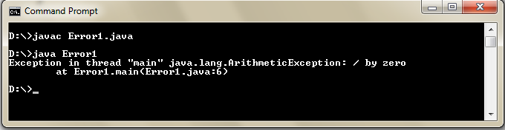
Ex:
class Error1
{
public static void main( String arg[])
{
int a=10; int b=5; int c=5;
int x= a/(b-c);
System.out.println( “x= “ +x);
int y=a/(b+c);
System.out.println( “y= “ +y);
}
}

Slide 7
If we want the program to continue with the execution of the remaining code, then we should catch the exception object thrown by the JRE and then display an appropriate message for taking corrective action.
This task is known as exception handling.

Slide 8
Exception Handling
Performing action in response to exception
Examples
  Exit program (abort)
  Ignore exception
  Deal with exception and continue
    Print error message
    Request new data

Slide 9
Scenario: Online Banking Transaction
Imagine you are using an online banking application to transfer money from your savings account to a friend's account. The application involves multiple steps, such as entering the recipient's account number, the amount to be transferred, and confirming the transaction.
Invalid Account Number Exception:
  Scenario: You mistakenly enter an incorrect recipient account number (e.g., a missing digit or an invalid format).
  Exception: The application raises an "InvalidAccountNumberException."
  Handling: The application catches this exception, displays an error message to you, and prompts you to correct the account number.

Slide 10
Insufficient Balance Exception:
  Scenario: You attempt to transfer an amount greater than your account balance.
  Exception: The application raises an "InsufficientBalanceException."
  Handling: The application catches this exception and informs you that you have insufficient funds for the transaction. You can either revise the transfer amount or cancel the transaction

Slide 11
Benefits of exception handling
It prevents program from automatically terminating.
Easy Identification of Program Code and Error-Handling Code
  The use of try/catch blocks separates error-handling code and program code making it easier to identify the flow of a program.
Meaningful Error Reporting

Slide 12
Meaningful Error Reporting:
  We can get the description of an exception in the form of a string by using the exception object and println() statement.
  Example :
  catch (ArithmeticException e) {
  System.out.println("Exception occurred: " + e);
  }
  The above catch statement displays the following output when an arithmetic exception occurs:
  Exception: java.lang.ArithmeticException: / by zero

Slide 13
  Traditional programming languages use error codes for error reporting. In the case of large programs, correcting errors using their error codes will be difficult.
  The meaningful descriptions provided by Java’s exception handling mechanism are helpful in correcting errors ( run time errors) .

Slide 14
Java Exception class hierarchy
EOFException
IOException
FileNotFoundException
Exception
ArithmeticException
ArrayIndexOutOfBoundsException
RuntimeException
StringIndexOutOfBoundsException
Object
Throwable
NumberFormatException
NullPointerException
VirtualMachineError
Ex: Stack overflow
Error
Checked
Unchecked

Slide 15
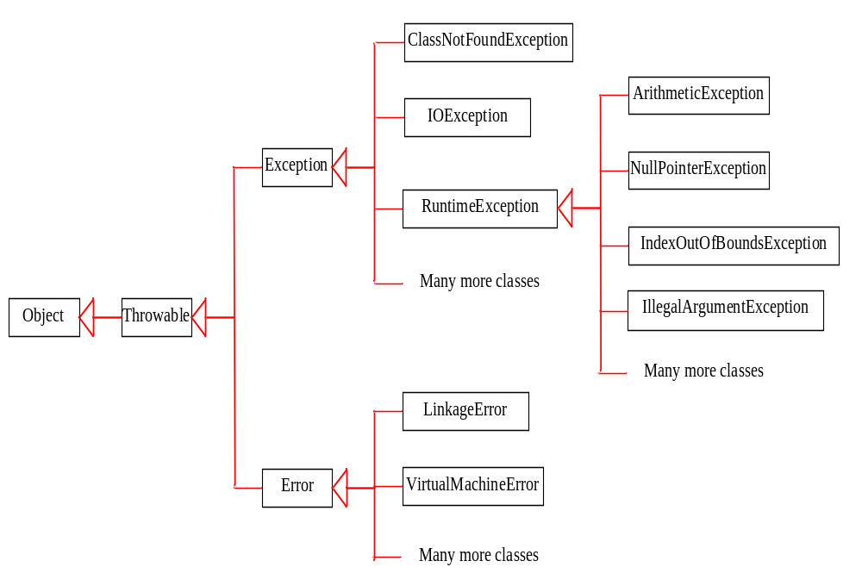
System Errors
System errors are thrown by JVM and represented in the Error class. The Error class describes internal system errors. Such errors rarely occur. If one does, there is little you can do beyond notifying the user and trying to terminate the program gracefully.

Slide 16
Exceptions
Exception describes errors caused by your program and external circumstances. These errors can be caught and handled by your program.

Slide 17
Runtime Exceptions
RuntimeException is caused by programming errors, such as bad casting, accessing an out-of-bounds array, and numeric errors.

Slide 18
All exception types are subclasses of the built-in class Throwable.
Throwable has two subclasses, they are
  Exception
    Represents exceptions that an user program might want to catch.
      Ex:- IOExceptions, RuntimeExceptins etc.
  Error
    Represents exceptions that are not expected to be caught by user program.
  i.e. Stack overflow

Slide 19
IOExceptions:-
  The Subclasses IOException represent exceptions that can occur during the processing of file input and output statements.
RuntimeExceptions:-
  The subclasses of RuntimeException represent exceptions that occur during the processing of a program ( other than file i/o statements).

Slide 20
Categories Of Exceptions
Unchecked exceptions
Checked exception

Slide 21
Characteristics Of Unchecked Exceptions
The compiler doesn’t give any error even if we do not catch these exceptions.
  No try-catch block or throws required by the compiler.
Examples:
  All the subclasses of RuntimeException and Error are unchecked exceptions.

Slide 22
Checked Exceptions
The compiler gives an error if we do not catch these exceptions.
  You must use a try-catch block or throws
Example:
  Subclasses of IOException are checked exceptions.

Slide 23
Uncaught Exceptions
This small program includes an expression that intentionally causes a divide-by-zero error:
class Exc0
{
public static void main(String args[])
  {
  int d = 0;
  int a = 42 / d;
}
}
Here is the exception generated when this example is executed:
java.lang.ArithmeticException: / by zero at Exc0.main(Exc0.java:4)

Slide 24
Exception-Handling Fundamentals
Exceptions can be generated by the Java run-time system, or they can be manually generated.
An exception can be caught to handle it or pass it on.
Java exception handling is managed by via five keywords: try, catch, throw, throws, and finally.

Slide 25
Exception-Handling Fundamentals
Program statements which might generate exceptions are kept inside a try block.
If an exception occurs within the try block, it is thrown.
Code within catch block catches the exception and handles it.
System generated exceptions are automatically thrown by the Java run-time system.
To manually throw an exception, use the keyword throw
Any exception that is thrown out of a method must be specified by a throws clause.

Slide 26
Using try and catch
Java try block is used to enclose the code that might throw an exception. It must be used within the method.
Java catch block is used to handle the Exception. It must be used after the try block only.
try{
//code that may throw exception
}
catch(Exception_class_Name ref)
{
}

Slide 27
Exception handling mechanism
try Block
Statements that
Cause an exception
catch Block
Statements that
handle the exception

Slide 28
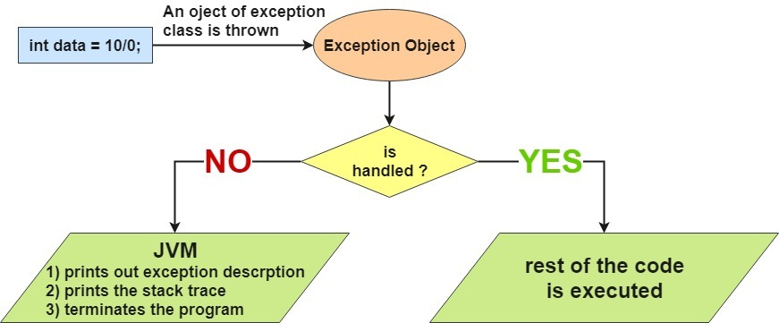
Internal working of java try-catch block

Slide 29
Try block can have one or more statements that could generate an exception.
If any one statement generates an exception the remaining statements in the block are skipped.
Every try block should be followed by at least one catch/finally statement; otherwise compilation error will occur.
Once the catch statement is executed, program execution continues with the next statement in the program following the entire try/catch mechanism.

Slide 30
Problem without exception handling
public class Testtrycatch1{
public static void main(String args[])
{
int data=50/0;//may throw exception
System.out.println("rest of the code...");
}
}
Exception in thread main java.lang.ArithmeticException:/ by zero
As displayed in the above example, rest of the code is not executed
(in such case, rest of the code... statement is not printed).

Slide 31
Solution by exception handling
public class Testtrycatch2{
public static void main(String args[]){
try{
int data=50/0;
}
catch(ArithmeticException e)
{System.out.println(e);}
System.out.println("rest of the code...");
}
}
Exception in thread main java.lang.ArithmeticException:/ by zero
rest of the code..

Slide 32
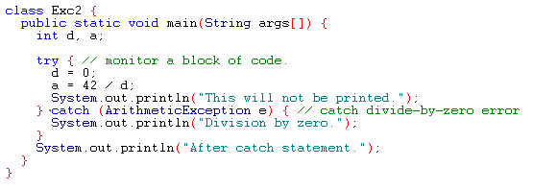
Ex :
Output:
Division by zero.
After catch statement.

Slide 33
Multiple catch Clauses
If a piece of code generates more than one exception, then we use multiple catch statements/blocks.
When an exception is thrown, each catch statement is verified in order, and the first one which matches that will be executed, and the remaining catch statements will be skipped.

Slide 34
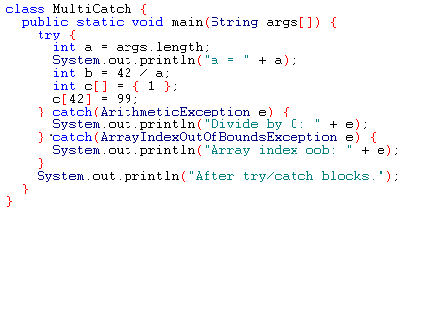
Ex :

Slide 35
Caution
Remember that, exception subclass must come before any of of their superclasses.
Because, a catch statement that uses a superclass will catch exceptions of that type plus any of its subclasses.
So, the subclass would never be reached if it comes after its superclass. This is an error in java.
For example, ArithmeticException is a subclass of Exception

Slide 36
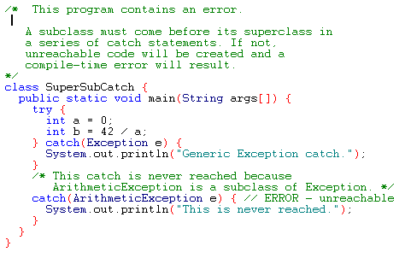
Example

Slide 37
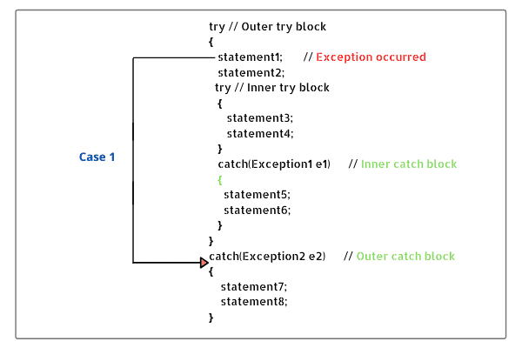
Nested try
The try statement can be nested. That is, a try statement can be inside the block of another try statement

Slide 38
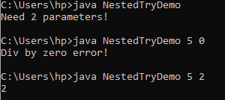
class NestedTryDemo
{
public static void main(String args[])
{
  try {
  int a = Integer.parseInt(args[0]);
    try
    {
    int b = Integer.parseInt(args[1]);
    System.out.println(a/b);
    }
    catch (ArithmeticException e) {
    System.out.println(“Div by zero error!");
    }
    }
    catch (ArrayIndexOutOfBoundsException) {
  System.out.println(“Need 2 parameters!");
}
}
}

Slide 39
throw
So far, you have only been catching exceptions that are thrown by the Java run-time system.
It is also possible for your program to throw an exception explicitly.
General form
throw new ThrowableInstance;
Here, ThrowableInstance must be an object of type Throwable or a subclass of Throwable

Slide 40
Creating Exceptions
Two ways to obtain a Throwable instance:
creating one with the new operator
All Java built-in exceptions have at least two Constructors: One without parameters and another with one String parameter:
throw new NullPointerException("demo");
using a parameter of the catch clause
try { … } catch(Throwable e) { … e … }

Slide 41
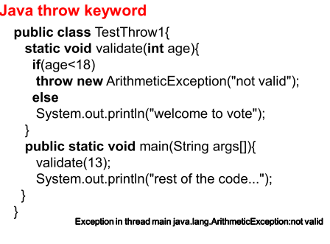

Slide 42
Example: throw
The method demo throws a
NullPointerException exception which
is immediately caught in the try block
and re-thrown:
class ThrowDemo
{
static void demo() {
  try {
  throw new NullPointerException("demo");
  } catch(NullPointerException e) { System.out.println("Caught inside demo function.");
  throw e;
  }
}
public static void main(String args[]){
try {
demo();
} catch(NullPointerException e) { System.out.println("Recaught: " + e);
}
}
}
The main method calls demo
within the try block which catches
and handles the NullPointerException
exception:

Slide 43
Using throws clause
If a method is capable of causing an exception that it does not handle, it must specify this behaviour so that callers of the method can guard themselves against that exception
You do this by including a throws clause in the method’s declaration.
If you don’t want the exception to be handled in the same function you can use the throws to handle the exception in the calling function.
A throws clause lists the types of exceptions that a method might throw
This is the general form of a method declaration that includes a throws clause:
    type method-name(parameter-list) throws exception-list
    {
    // body of method
    }
    Here, exception-list is a comma-separated list of the exceptions that a method can throw.

Slide 44
class ThrowsDemo
{
static void throwOne() throws IllegalAccessException
{
System.out.println("Inside throwOne.");
throw new IllegalAccessException("demo");
}
public static void main(String args[])
{
try
{
throwOne();
}
catch (IllegalAccessException e)
{
System.out.println("Caught " + e);
}
}

Slide 45
import java.io.IOException;
class Testthrows1{
void m()throws IOException{
throw new IOException("device error");//checked exception
}
void p(){
try{
m();
}catch(Exception e){System.out.println("exception handled");}
}
public static void main(String args[])
{
Testthrows1 obj=new Testthrows1();
obj.p();
System.out.println("normal flow...");
} }
Output:
exception handled
normal flow...

Slide 46
finally
A finally block is a block that appears after all of the catch blocks.
It’s executed whether or not any exceptions are thrown by the try block or caught by any catch blocks.
Its purpose is to execute important code such as closing files, database connection etc., which were opened earlier before returning from the method.

Slide 47
finally
When an exception is thrown:
    the execution of a method is changed
    the method may even return prematurely.
This may be a problem is many situations.
For instance, if a method opens a file on entry and closes on exit; exception handling should not bypass the proper closure of the file.
The finally block is used to address this problem.

Slide 48
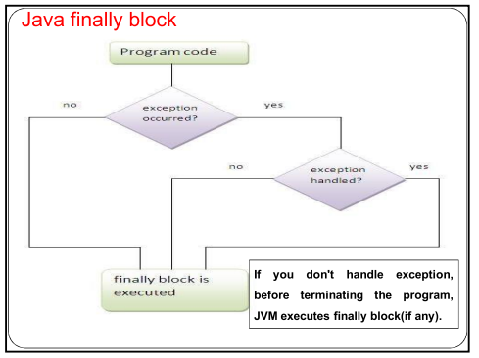

Slide 49
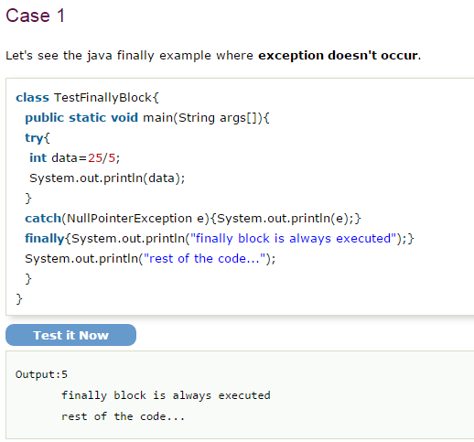

Slide 50
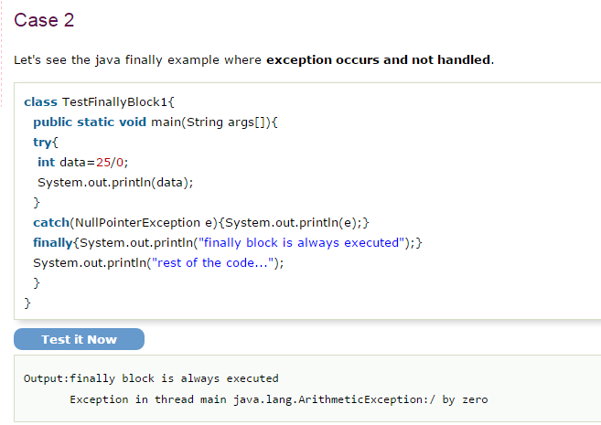

Slide 51
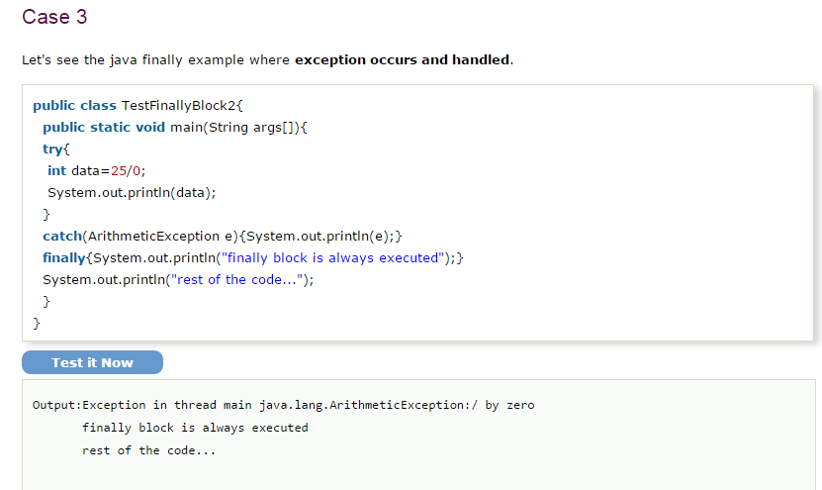

Slide 52
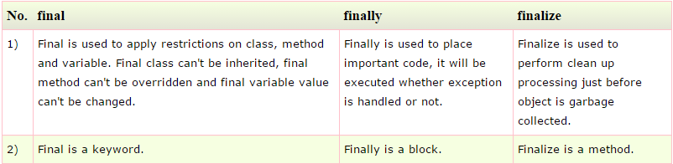
Difference between final, finally and finalize
Finalize is used to
Release the resources
held by the object just
before the object is
deleted by the
garbage collector.

Slide 53
Java’s Built-in Exceptions
Java defines several exception classes in java.lang package and java.io package.
Unchecked Exceptions defined in java.lang
Exception Meaning
ArithmeticException Arithmetic error, such as divide-by- zero.
ArrayIndexOutOfBoundsException Array index is out-of-bounds.
NegativeArraySizeException Array created with a negative size.
NullPointerException Invalid use of a null reference.
NumberFormatException Invalid conversion of a string to a numeric format.
StringIndexOutOfBounds Attempt to index outside the bounds of a string.

Slide 54
Checked Built-In Exceptions
Methods that generate but do not handle those exceptions must declare them in the throws clause:
NoSuchMethodException NoSuchFieldException
InterruptedException
InstantiationException
IllegalAccessException
CloneNotSupportedException
ClassNotFoundException

Slide 55
Creating Own Exception Classes
Build-in exception classes handle some generic errors.
For application-specific errors we need to define our own exception classes.
If you are creating your own Exception that is known as custom exception or user-defined exception.
Java custom exceptions are used to customize the exception according to user need.
User defined exception needs to inherit (extends) Exception class in order to act as an exception.
throw keyword is used to throw such exceptions.

Slide 56
Syntax:
Define a subclass of Exception:
class MyException extends Exception
{
…
}
MyException need not implement anything – its mere existence in the type system allows to use its objects as exceptions.
class InvalidAgeException extends Exception
{
public InvalidAgeException (String str)
{
// calling the constructor of parent Exception
super(str);
}
}

Slide 57
public class TestCustomException1
{
// method to check the age
static void validate (int age) throws InvalidAgeException{
if(age < 18){
// throw an object of user defined exception
throw new InvalidAgeException("age is not valid to vote");
}
else {
System.out.println("welcome to vote");
}
}
public static void main(String args[])
{
try
{
validate(13); // calling the method
}
catch (InvalidAgeException ex)
{
System.out.println("Caught the exception");
// printing the message from InvalidAgeException object
System.out.println("Exception occured: " + ex);
}
System.out.println("rest of the code...");
}
}

Slide 58
class EmployeeException extends Exception
{
  public EmployeeException(String s)
  {
  super(s);
  }
}
class SampleEmp
{
  void empIDCheck(int EmpID) throws EmployeeException{
  if(EmpID<=0 || EmpID>999)
  {
  throw new EmployeeException("Invalid Employee ID");
  }
}
public static void main(String args[])
{
  SampleEmp emp = new SampleEmp();
  try
  {
  emp.empIDCheck(0);
  }
  catch (EmployeeException e)
  {
    System.out.println("Exception caught");
    System.out.println(e.getMessage());
  }
  }
}
Output:
Exception caught
Invalid Employee ID

Slide 59
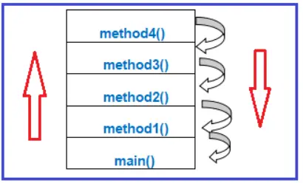
Propagating Exceptions
The process of sending exceptions from called method to the calling method is called exception propagation.
If an exception is propagated and if that exception is not caught in that calling method, not only is called method execution but also calling method execution is terminated

Slide 60
Exception propagation : An exception is first thrown from the top of the stack and if it is not caught, it drops down the call stack to the previous method.
After a method throws an exception, the runtime system attempts to find something to handle it.
The set of possible “somethings” to handle the exception is the ordered list of methods that had been called to get to the method where the error occurred.
The list of methods is known as the call stack and the method of searching is Exception Propagation.

Slide 61
class ExceptionPropagation { public void method4 () { int a = 10, b = 0; int c = a / b; } public void method3 () { this.method4 (); System.out.println ("after method 4 compltion"); } public void method2 () { this.method3 (); System.out.println ("after method 3 compltion"); } public void method1 () { this.method2 (); System.out.println ("after method 2 compltion"); } public static void main (String args[]) { ExceptionPropagation ep = new ExceptionPropagation (); ep.method1 (); System.out.println ("after method 1 completion"); } }
class ExceptionPropagation
{
public void method4 ()
{
int a = 10, b = 0;
int c = a / b;
}
public void method3 ()
{
this.method4 ();
System.out.println ("after method 4 compltion");
}
public void method2 ()
{
this.method3 ();
System.out.println ("after method 3 compltion");
}
public void method1 ()
{
this.method2 ();
System.out.println ("after method 2 compltion");
}
public static void main (String args[])
{
ExceptionPropagation ep = new ExceptionPropagation ();
ep.method1 ();
System.out.println ("after method 1 completion");
}
}

Slide 62
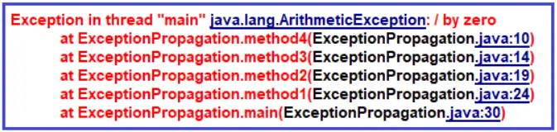

Slide 63
Chained Exceptions in Java
In Java, a chained exception is a technique that enables programmers to associate one Exception with another.
By providing additional information about a specific exception, debugging can be made easier.
A chained exception is created by wrapping an existing exception in a new exception, which becomes the root cause of the new Exception.
The new Exception can provide additional information, while the original Exception contains the actual error message and stack trace.
It makes it easier to determine and fix the problem's source.
Chained exceptions are especially useful when an exception is thrown due to another exception.

Slide 64
// Java program to demonstrate working of chained exceptions
public class ExceptionHandling
{
public static void main(String[] args)
{ try
{
// Creating an exception
NumberFormatException ex = new NumberFormatException("Exception");
// Setting a cause of the exception
ex.initCause(new NullPointerException( "This is actual cause of the exception"));
// Throwing an exception with cause.
throw ex;
}
catch(NumberFormatException ex)
{
// displaying the exception
System.out.println(ex);
// Getting the actual cause of the exception
System.out.println(ex.getCause());
}
}
}
Output:
java.lang.NumberFormatException: Exception java.lang.NullPointerException: This is actual cause of the exception

Slide 65
Assertions in java
Assertion is a statement in java.
It can be used to test your assumptions about the program.
An assertion allows testing the correctness of any assumptions that have been made in the program.
An assertion is achieved using the assert statement in Java.
While executing assertion, it is believed to be true. If it fails, JVM throws an error named AssertionError.
It is mainly used for testing purposes during development.

Slide 66
The assert statement is used with a Boolean expression and can be written in two different ways.
First way:
assert expression;
Second way:
assert expression1 : expression2;
Example:
// Java program to demonstrate syntax of assertion
import java.util.Scanner;
class Test {
public static void main(String args[])
{
int value = 15;
assert value >= 20 : " Underweight";
System.out.println("value is " + value);
}
}
Output: value is 15

Slide 67
After enabling assertions:
Output:
Exception in thread "main" java.lang.AssertionError: Underweight
Enabling Assertions
By default, assertions are disabled.
The syntax for enabling assertion statement in Java source code is:
    java –ea Test
    Or
    java –enableassertions Test
Disabling Assertions
The syntax for disabling assertions in java is:
  java –da Test
  Or
  java –disableassertions Test
  Here, Test is the file name.

